Slide 1
May 18th Updates:
Calculated Joint torques from last meeting:
Problems: Start of stride and end stride not meet, Sharp magnitude changes between swing and stance phase.

Slide 2
Stance Torque data from Emanuel
Modified Stance Torque data of Lagrange Approach
There is still difference between both method, So I consulted with Emanuel
Notes:
Changed to same direction of positive rotation and minor edition on the Coriolis terms

Slide 3
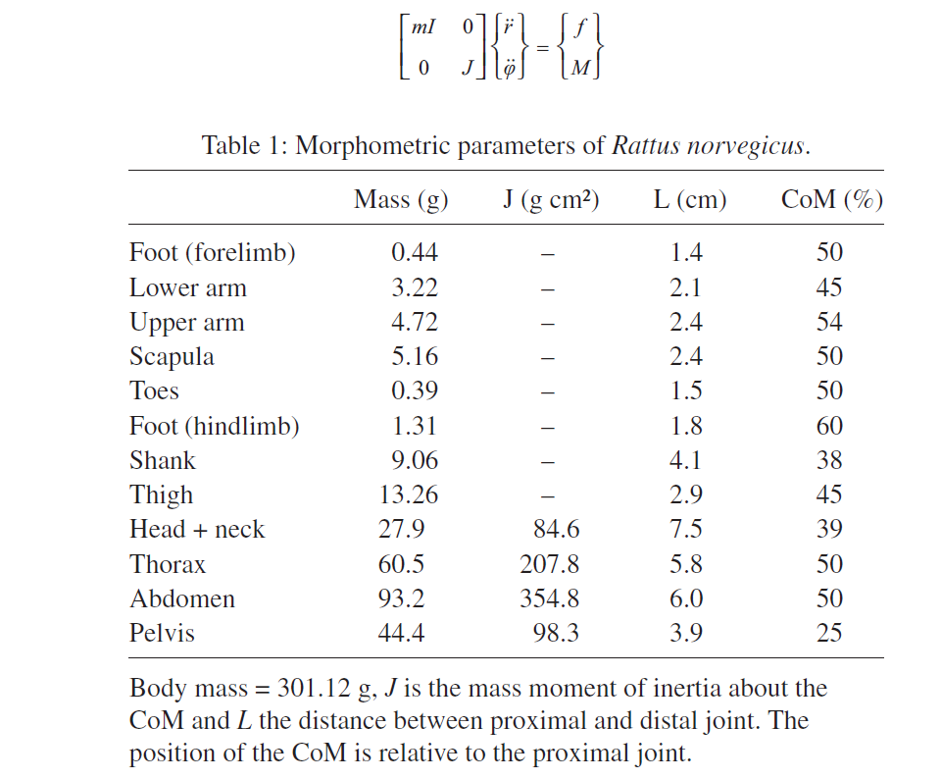
The reason the difference exist as:
Emanuel is using Newtown-Eulerian approach:
Also, the Parameter of each segment we calculating is different:
Body Our model Emanuel
Pelvis 31.8 44.4
Femur 14.1 13.26
Tibia 3.3 9.06
Foot 1.6 1.7
But the major reason cause the difference is we only used kinematic data to calculate the torque. Emanuel state he calculate the torques using force and kinematic data together.
The force data is SRF (ground reaction force).
(Winter D.A. 2010 Biomechanics and Motor Control of Human Movement. New York, John Wiley and Sons).

Slide 4
Swing torques:
Emanuel’s Stance Torques
Alex’s Swing Torques
Lagrange Swing Torques
Lagrange Swing Torques(2)

Slide 5
Total torques (unsmoothed data):
Emanuel’s Torques
Alex’s Torques
Lagrange Torques
Lagrange Torques(2)

Slide 7
Total torques (smoothed data):
Emanuel’s Torques
Alex’s Torques
Lagrange Torques
Lagrange Torques(2)

